Slide 1
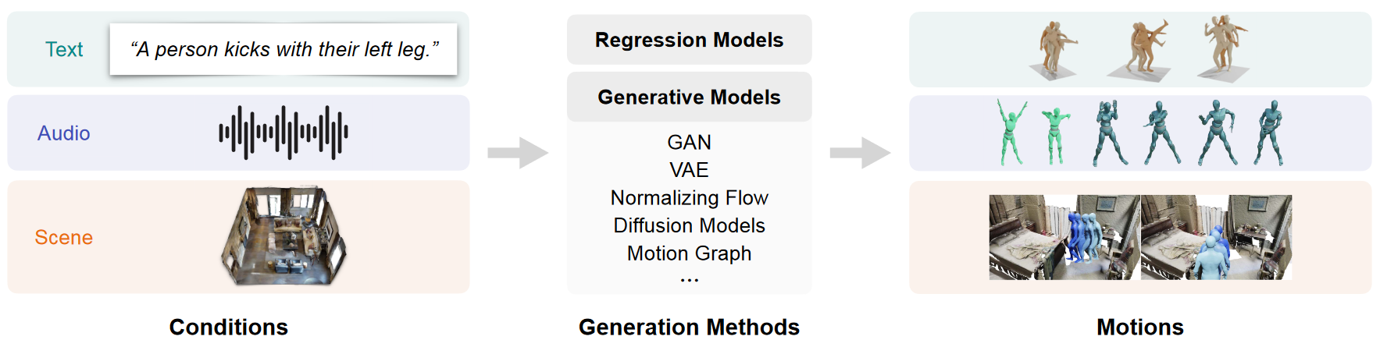

Tutorial : human motion generation
An overview of typical human motion generation approaches
Human Motion Generation: A Survey arxiv 2023

Slide 2
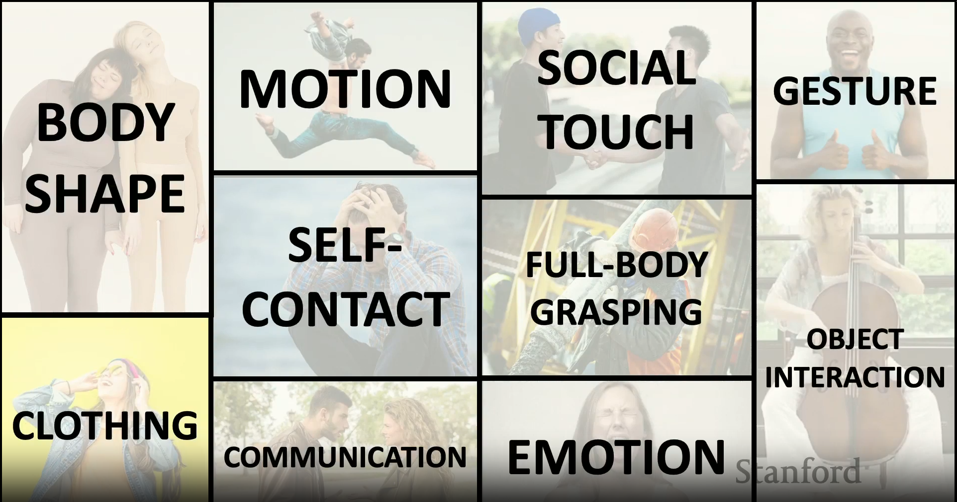
https://acorn.stanford.edu/SCIEN/video/2024_MichaelBlack.mp4

Slide 3
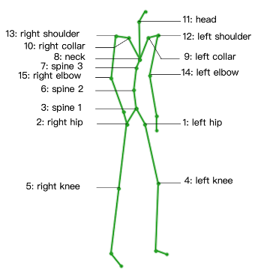
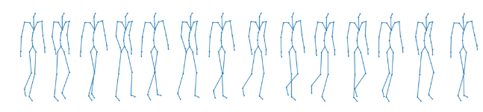
Preliminaries : motion data
Motion : the sequence of human body poses over the temporal dimension
Given timestep T, different joints have spatial relationship
A Spatio-temporal Transformer for 3D Human Motion Prediction 3DV 2021

Slide 4
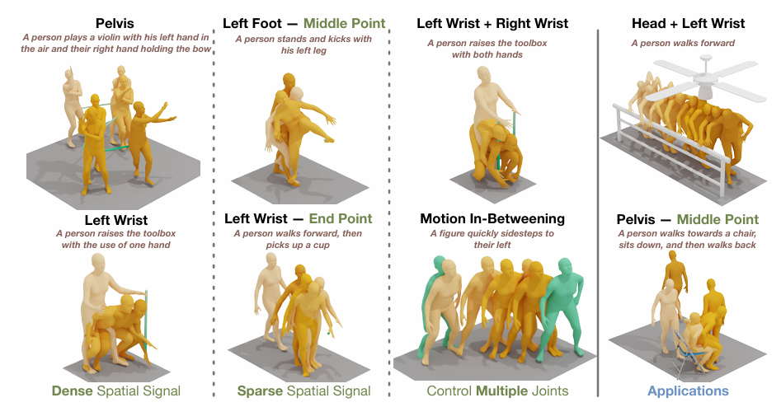
Preliminaries : motion data
Motion : the sequence of human body poses over the temporal dimension
Given certain joint J, its trajectory has temporal relationship
OmniControl: Control Any Joint at Any Time for Human Motion Generation ICLR 2024

Slide 5
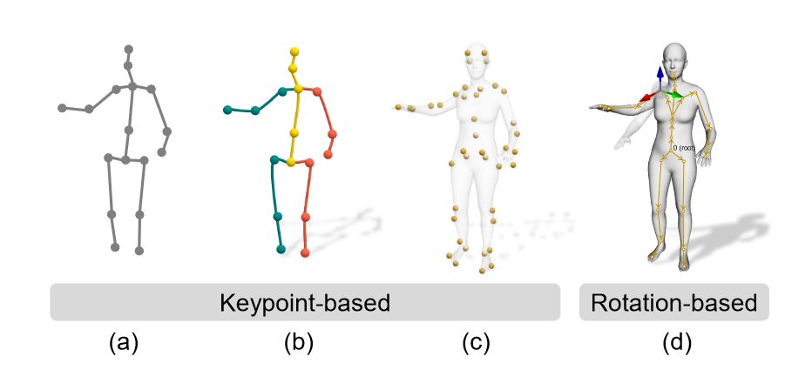
Preliminaries : motion representation
(a) 2D keypoints (b) 3D keypoints (c) 3D marker keypoints
(d) rotation-based model
Human Motion Generation: A Survey arxiv 2023

Slide 6
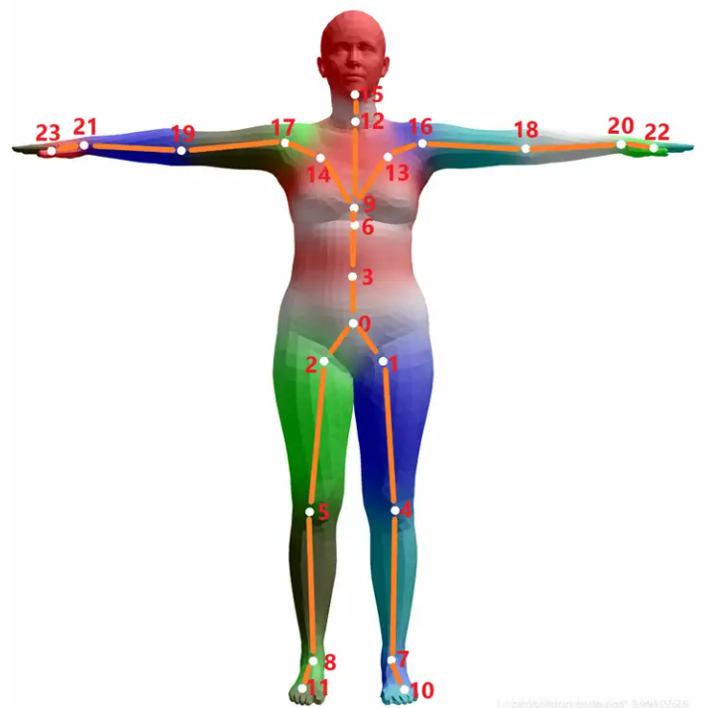
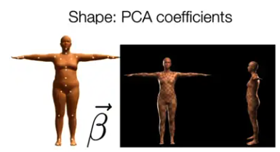
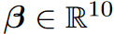
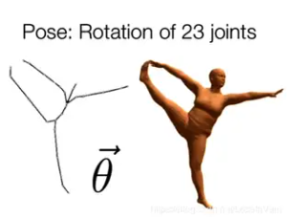
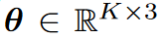
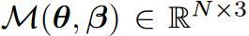
Preliminaries : motion representation
Human Motion Generation: A Survey arxiv 2023

Slide 7
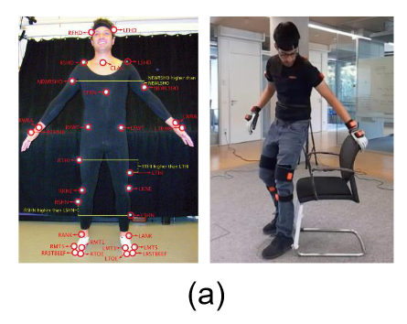
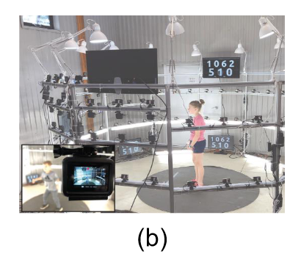
Preliminaries : motion collection
Marker-based
Inertial Measurement Units (IMUs)
reflective markers
more accurate
b) Markerless
multiple RGB or RGB-D cameras
more convenient but less accurate
detection + pose estimation
Human Motion Generation: A Survey arxiv 2023

Slide 8
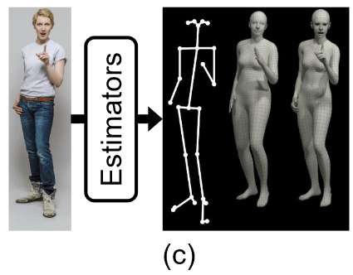
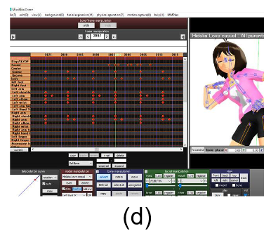
Preliminaries : motion collection
c) Pseudo-labeling
in-the-wild captured monocular RGB image
more general
more error
d) Manual annotation
expensive, time consuming, not scalable
Human Motion Generation: A Survey arxiv 2023

Slide 9
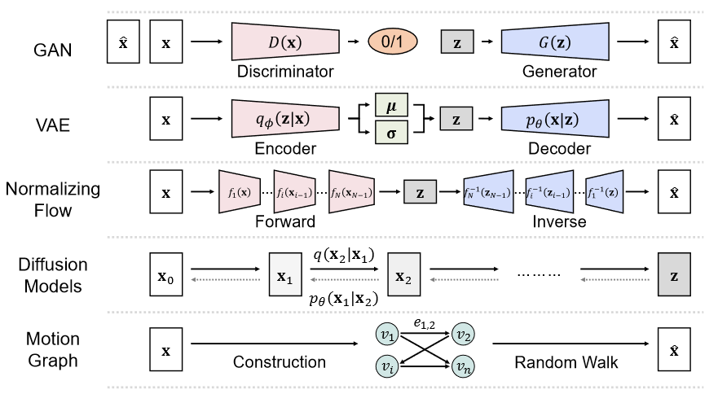
Preliminaries : generative model
Human Motion Generation: A Survey arxiv 2023

Slide 10
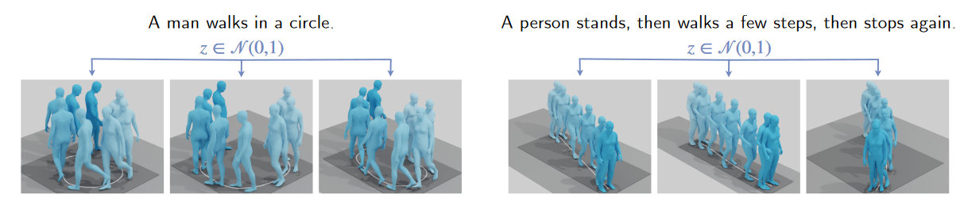
Text-conditioned motion generation
A single text command can correspond to multiple action sequences
Align the distributions between motion and text
TEMOS: Generating diverse human motions from textual descriptions CVPR 2022

Slide 11
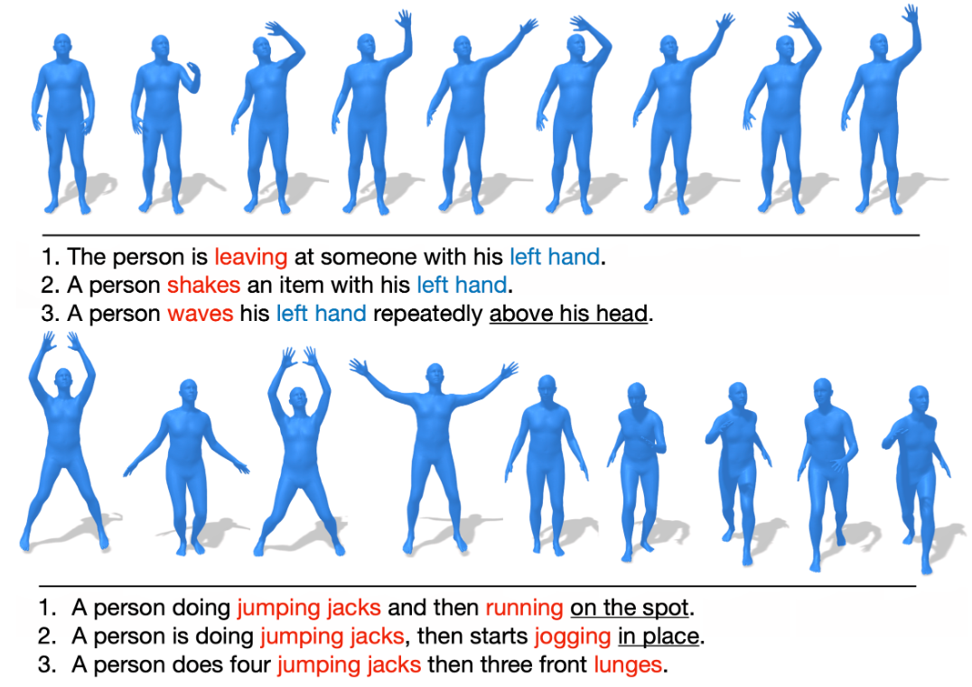
Dataset
Human Motion Generation: A Survey arxiv 2023
HumanML3D CVPR 2022

Slide 12
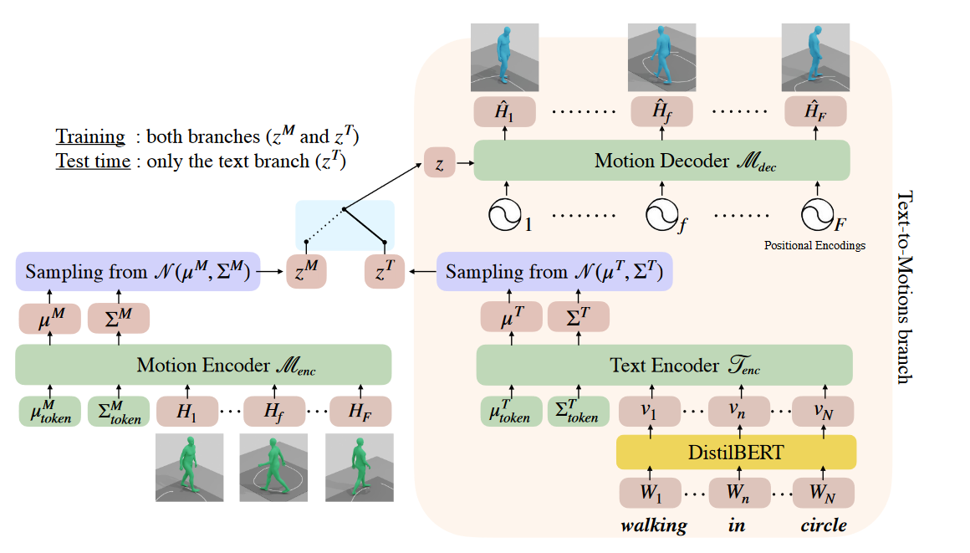
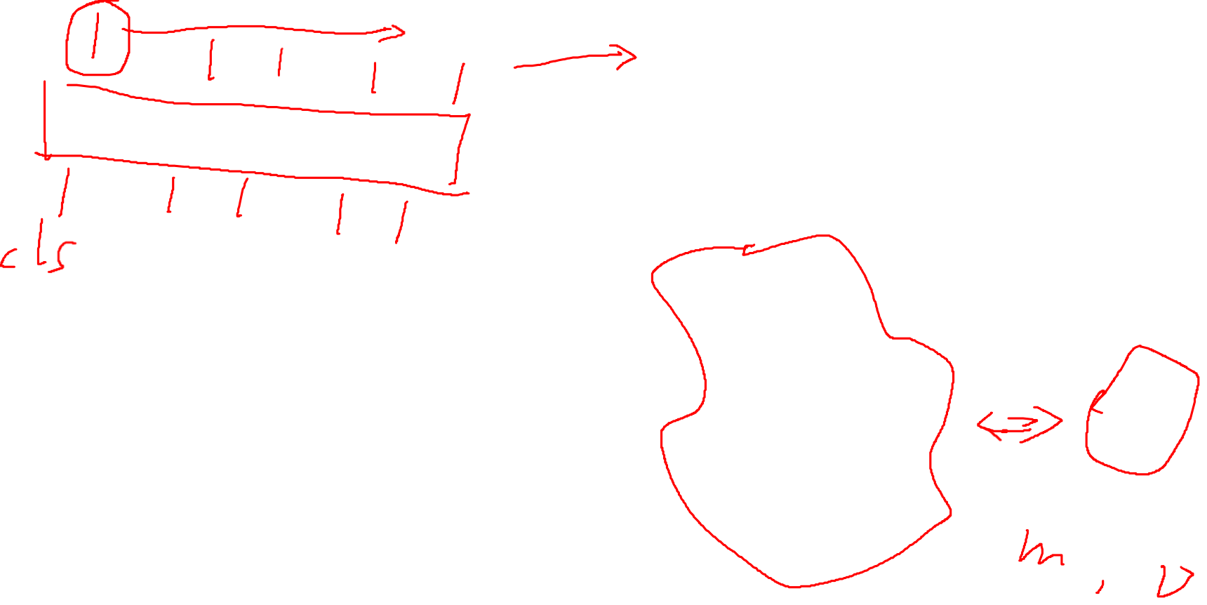
Text-conditioned motion generation
TEMOS: Generating diverse human motions from textual descriptions CVPR 2022

Slide 13
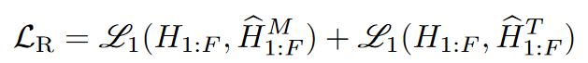
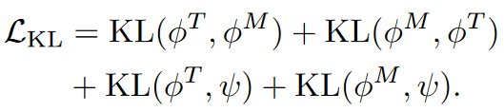
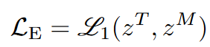
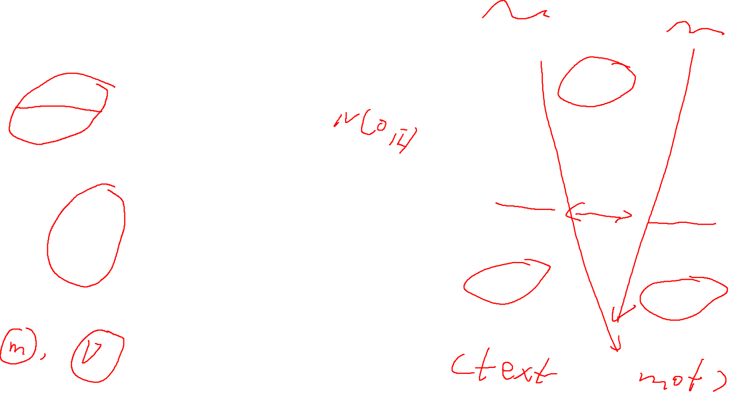
Training loss in TEMOS
Reconstruction losses
KL losses
Cross-modal embedding similarity loss
TEMOS: Generating diverse human motions from textual descriptions CVPR 2022

Slide 14
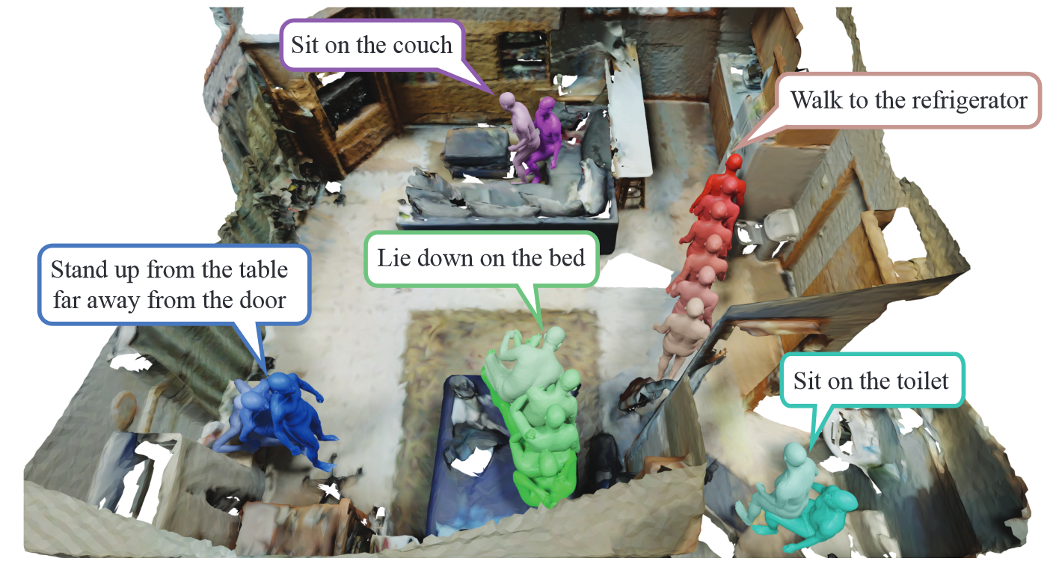
Scene-conditioned motion generation
HUMANISE: Language-conditioned Human Motion Generation in 3D Scenes NIPS 2022

Slide 15
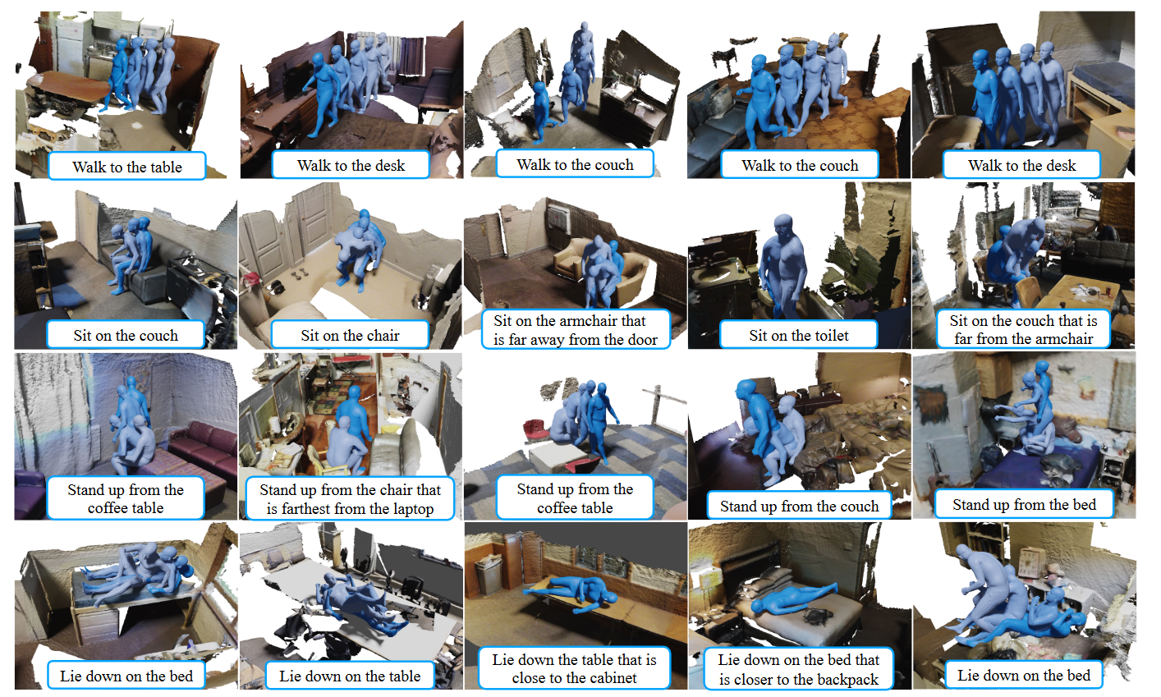
Dataset
HUMANISE: Language-conditioned Human Motion Generation in 3D Scenes NIPS 2022

Slide 16
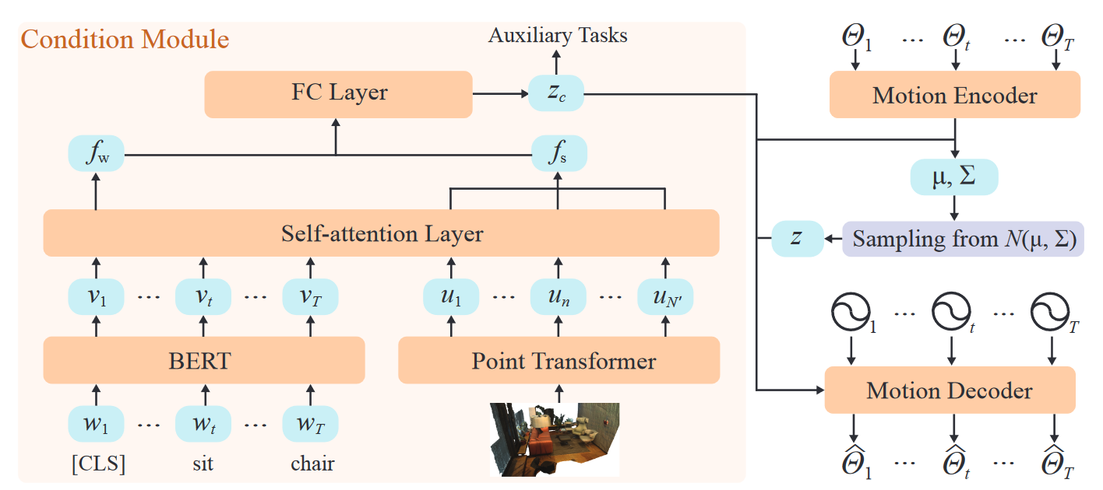
Scene-conditioned motion generation
HUMANISE: Language-conditioned Human Motion Generation in 3D Scenes NIPS 2022

Slide 17
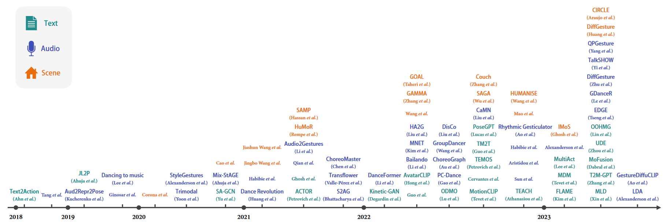
Recent advances of methods
Human Motion Generation: A Survey arxiv 2023

Slide 18
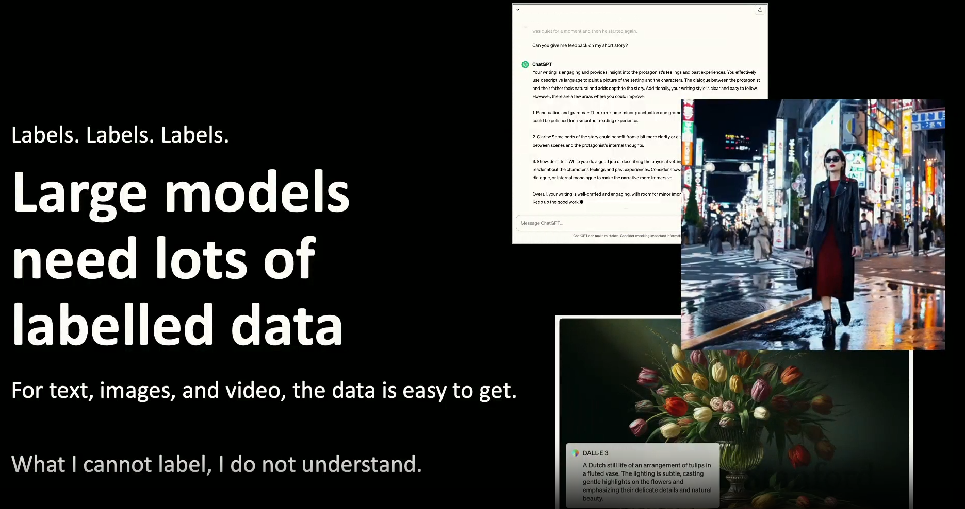
https://acorn.stanford.edu/SCIEN/video/2024_MichaelBlack.mp4

Slide 19
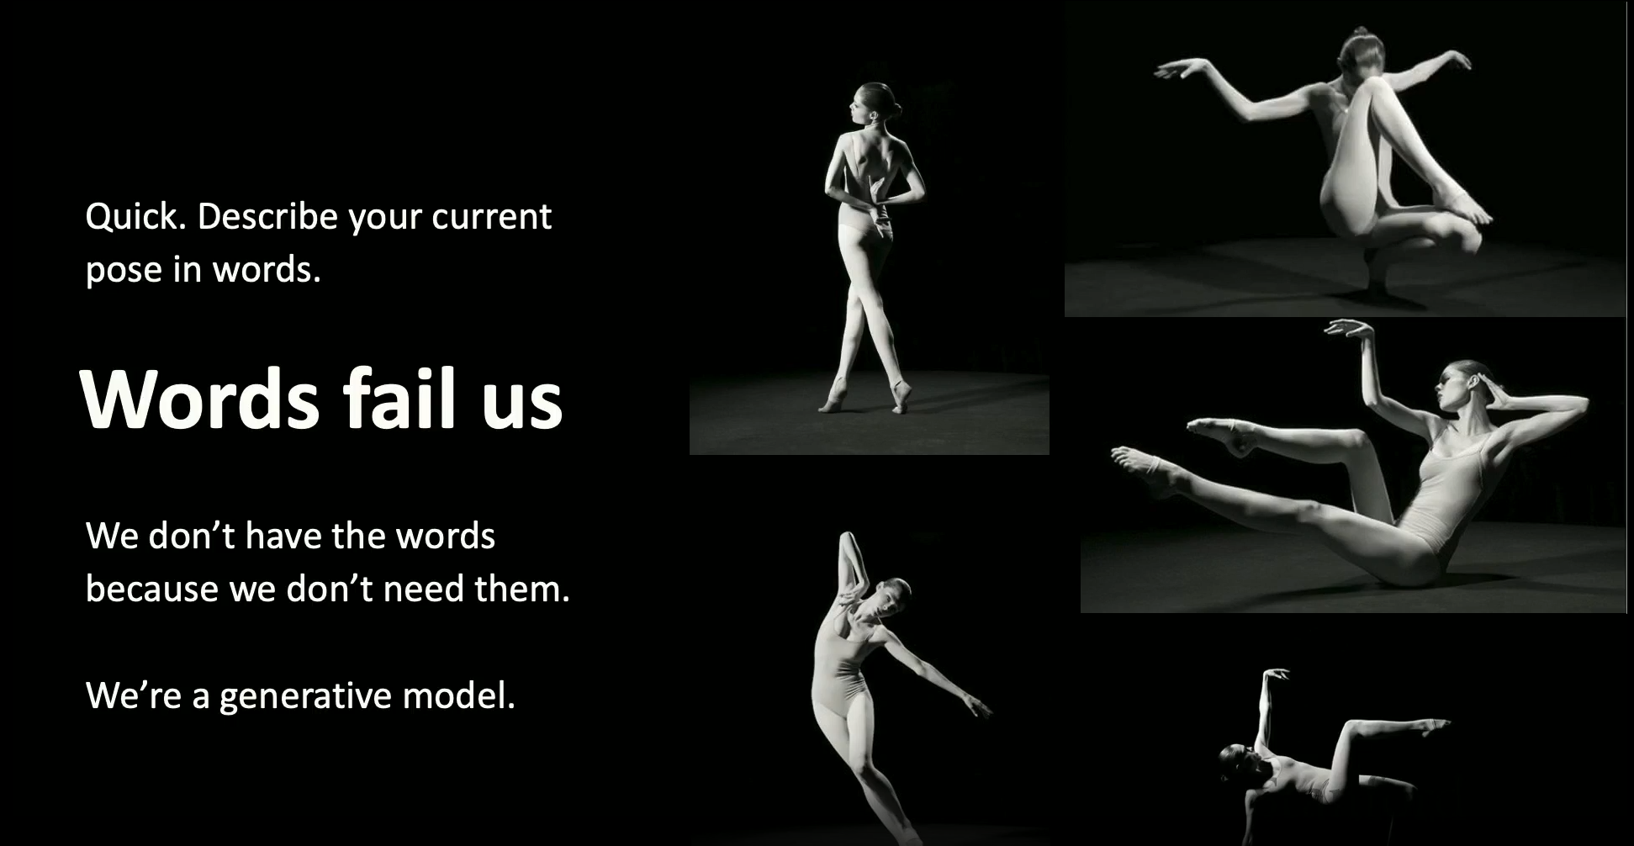
https://acorn.stanford.edu/SCIEN/video/2024_MichaelBlack.mp4

Slide 20
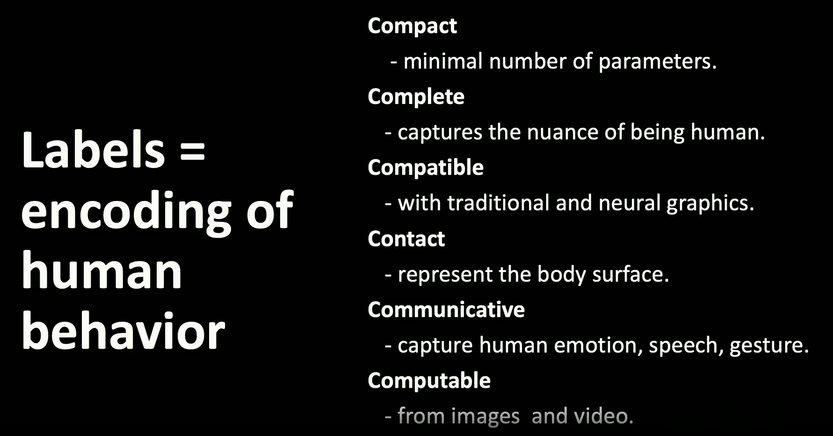
https://acorn.stanford.edu/SCIEN/video/2024_MichaelBlack.mp4

Slide 21
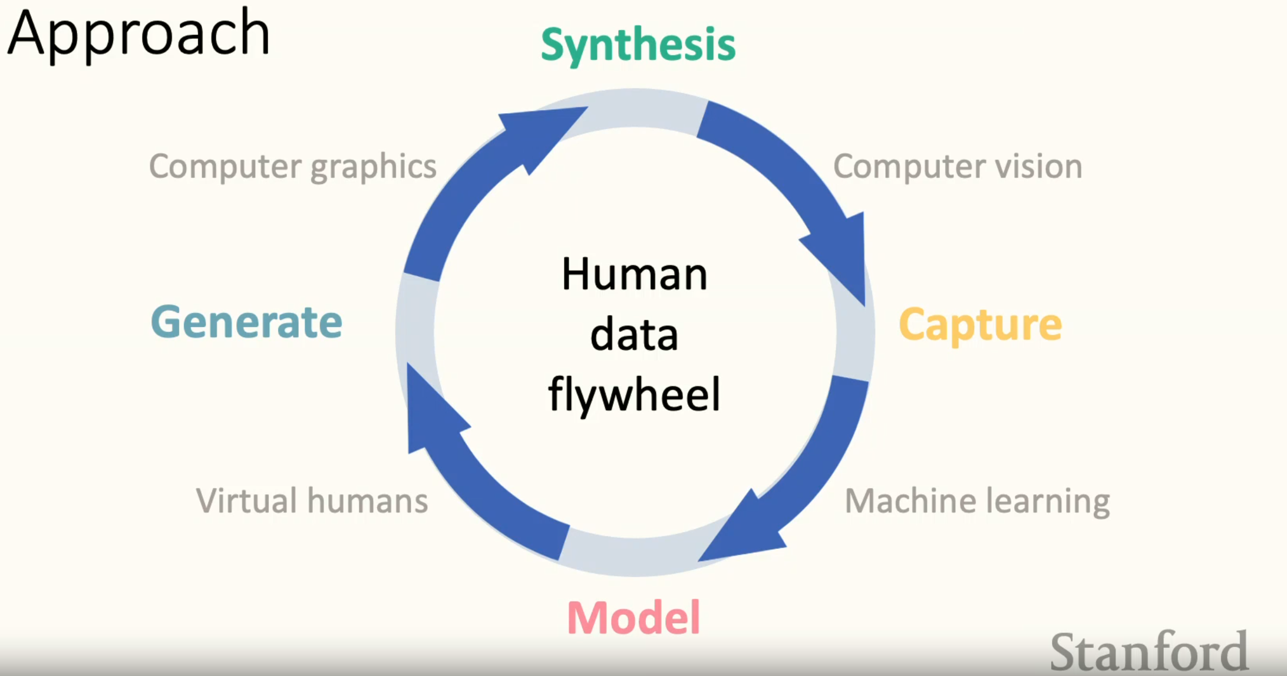
https://acorn.stanford.edu/SCIEN/video/2024_MichaelBlack.mp4

Slide 22
